Slide 1
Heart Disease Diagnostic Analysis
MADE BY: Divyam Raghav
divyamraghav2004@gmail.com

Slide 2
Introduction
The COVID-19 pandemic has highlighted the critical importance of health as a foundational aspect of well-being. With heart disease remaining one of the leading causes of death globally, it is imperative to analyze related data for better preparation and prevention strategies. This analysis focuses on heart disease diagnostics, aiming to uncover trends and key factors that can help inform healthcare decisions and policies.

Slide 3
Details of Data
Dataset Size: 303 observations, each representing a patient.
2. Key Variables: Demographics: Age, Gender (Male/Female).
Clinical Data: Chest pain type, Resting blood pressure, Serum cholesterol levels.
Diagnostic Results: Fasting blood sugar, Resting ECG, Maximum heart rate, ST depression (oldpeak).
Indicators: Exercise-induced angina, Number of major vessels, Thalassemia type
3. Target Variable: Presence of heart disease (1 = Yes, 0 = No).

Slide 4
Main KPIs
Heart Disease Prevalence: The target variable shows that 165 out of 303 patients (54.5%) have been diagnosed with heart disease.
Gender Distribution: Heart disease is more prevalent in males (68.5%) compared to females (31.5%).
Age Group Analysis: The highest prevalence of heart disease is observed in the 55-65 age group, making up 39% of the cases.
Cholesterol Levels: High cholesterol levels (above 240 mg/dl) are strongly associated with a higher likelihood of heart disease.
Chest Pain Types: Typical angina is most common among patients with heart disease, followed by atypical angina.

Slide 5
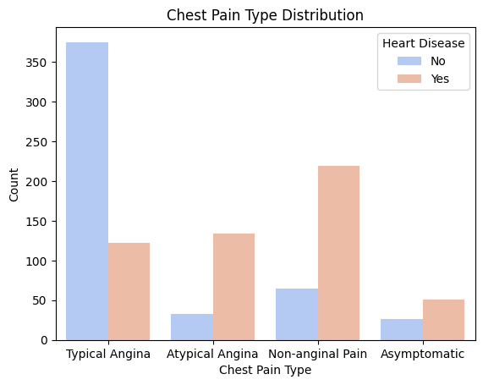
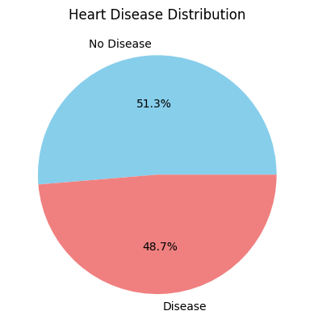
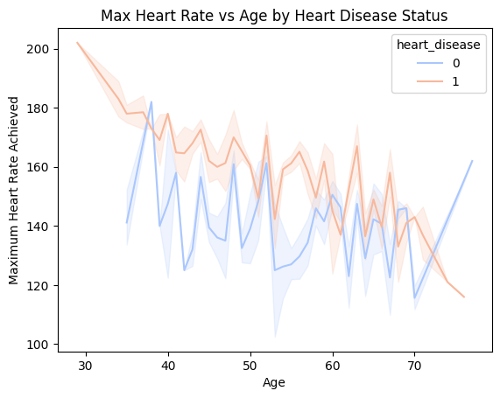
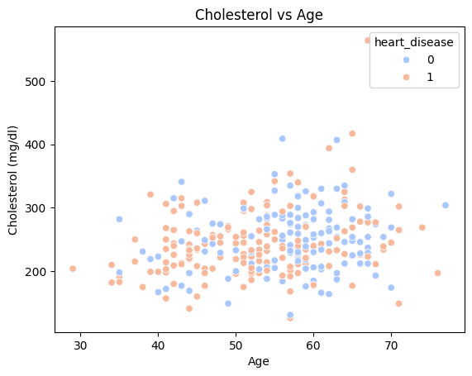
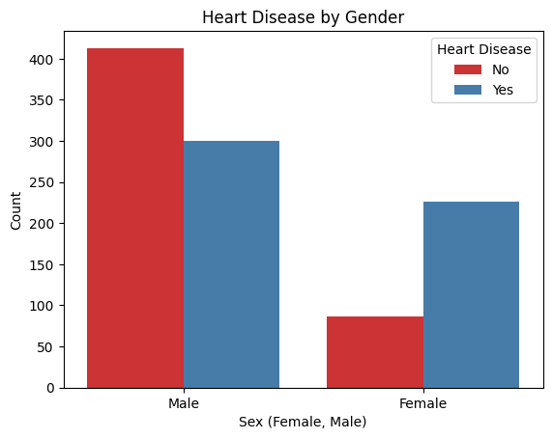
Dashboard

Slide 6
Key Findings
Gender Disparity: The data reveals a significant gender disparity, with males being more susceptible to heart disease than females.
Age Factor: The risk of heart disease increases with age, particularly in individuals aged 55-65 years.
Cholesterol Levels: High cholesterol is a strong indicator of heart disease risk, emphasizing the need for cholesterol management in preventative healthcare.
Chest Pain as a Diagnostic Tool: The type of chest pain a patient experiences can be a strong indicator of heart disease, with typical angina being most closely associated with the condition.
Prevalence: More than half of the analyzed patients were diagnosed with heart disease, underscoring the importance of regular screening and early intervention.

Slide 7
Thank you

